Slide 1

Spotify
By: Sawyer Mason & John Cason

Slide 2
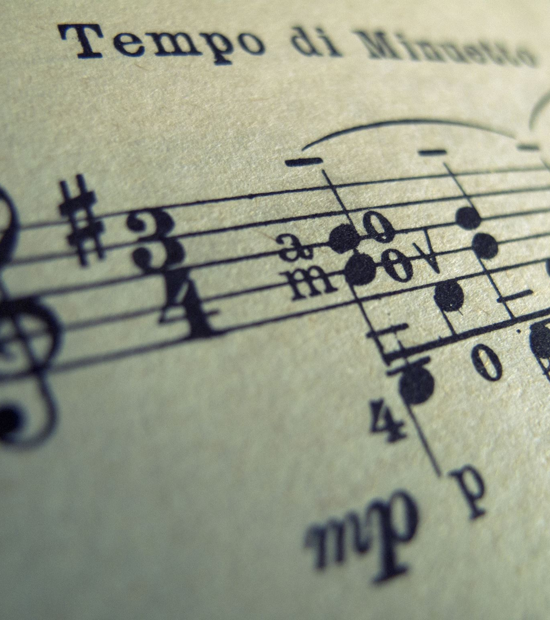
Spotify top 10k songs 1960 to 2023
Kaggle
Data set is limited to Spotify Music
Don’t take relationship as fact due to limited size
This data set contains 10,000 samples with 29 columns with 1 bool, 1 datetime, 12 float64, 4 int64, and 11 object data types
Popularity of Genres and Artists and are there any defining relationships

Slide 3
Data Cleaning
Used .head() and .info() to keep up with column names and check for null values
Used .drop() to get rid of null variables and non useful columns
Added variable year by using date time
Used .head() to check year variable

Slide 4
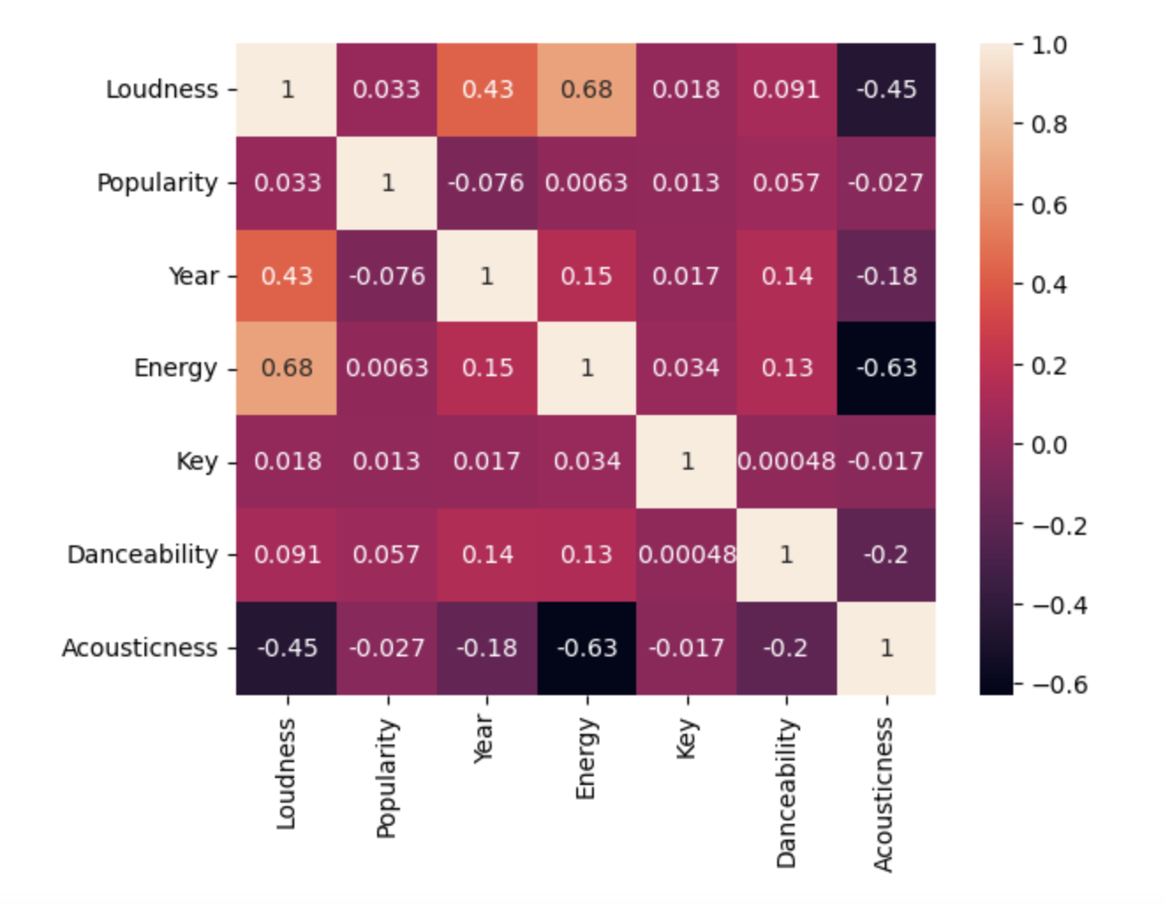
Correlation Heatmap
Strong positive correlation with Loudness and Energy
Strong negative correlation with Energy and Acousticness
Nothing correlated to popularity

Slide 5
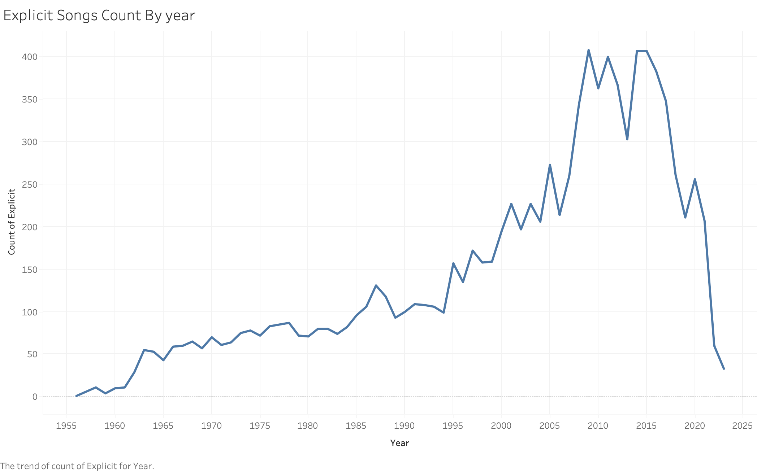
Explicit songs have risen since 1955 which points to it correlating with popularity

Slide 6
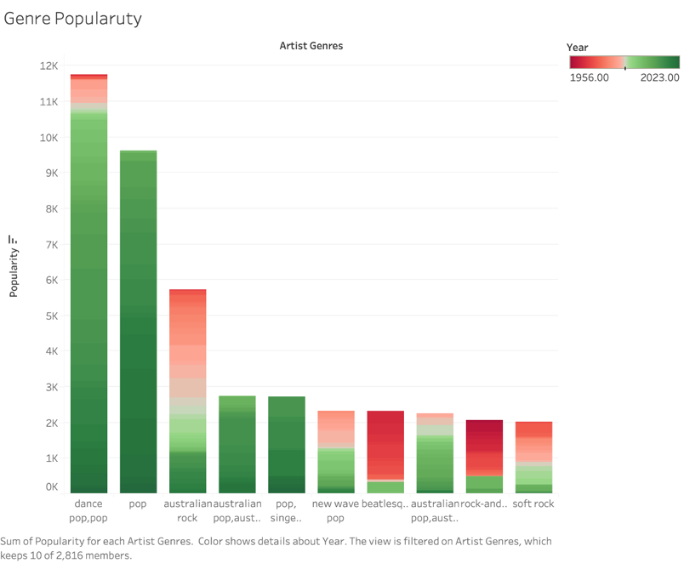
Genre by Popularity through the years
Mostly pop and rock types of songs were popular especially in recent history

Slide 7
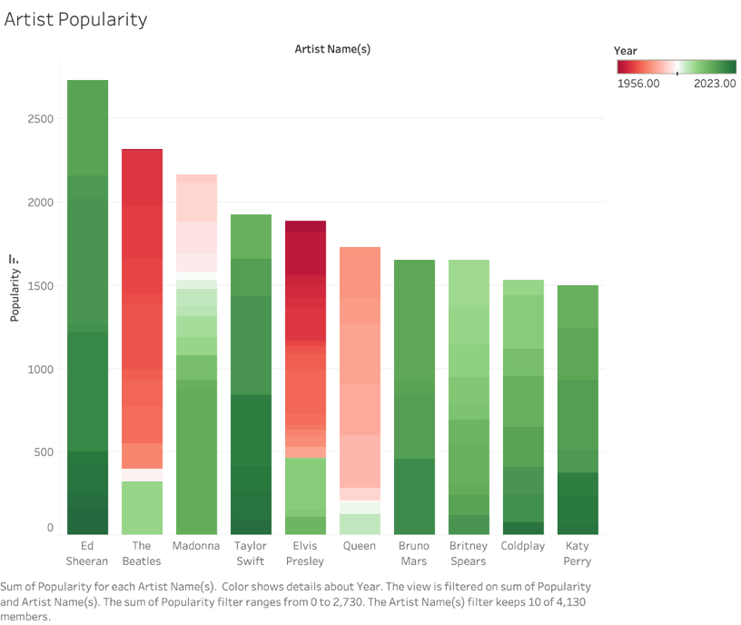
Artist Popularity through the years.
Note how Beatles, Elvis, Queen are older bands but still remain popular.
Could be due to the recent movies made on these bands

Slide 8
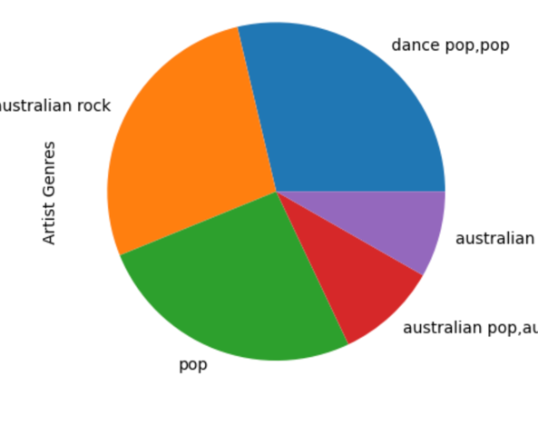
Most popular genres on Spotify

Slide 9

Discussion/Conclusion
No musical element had any correlation to popularity
Rock and Pop have proven to be the most popular genres
Artists from these genres tend to have higher popularity scores as proven in our graphs
The rise in explicit music seems to show that it has become more popular in todays time
Not many categorical variables that were easy to use

Slide 10

Q&A

